Slide 1
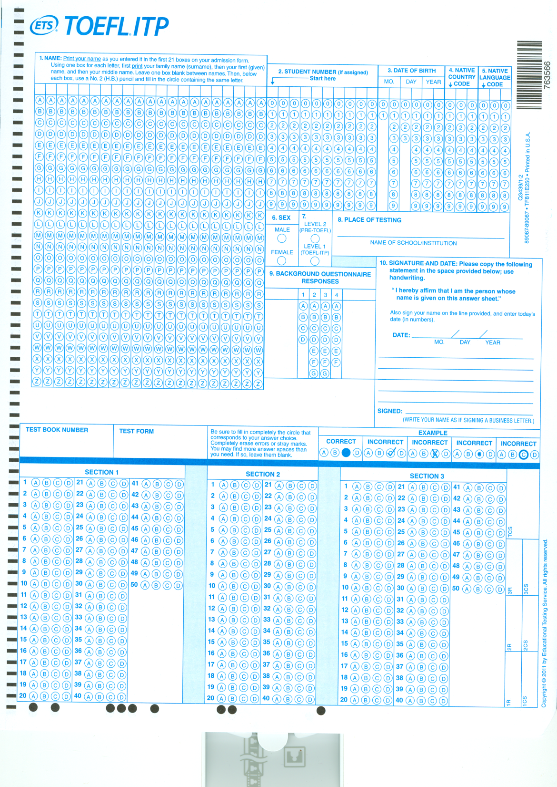
Native country code - Slovakia 503, others - ask
Native language code – Slovakia 473, others – ask
# 9, Question 4 – how many years of English have you had - D -> 2 to 5 years, others ask
N E M C O V A B O Z E N A
0 2 3 1 8 0
1 4 2 4 1 3
UNIVERSITY OF SOUTH BOHEMIA
6 14 2014
I hereby affirm that I am the person
whose name is given on this sheet
Bozena Nemcova
0067066
4ITN05A

